Slide 1
TREATING OBESITY & preventing T2D in PWH Lessons from a clinical trial of GLP-1 RAs in SOUTH AFRICA
Jen Manne-Goehler, MD, ScD
Assistant Professor, Harvard Medical School
Division of Infectious Diseases, BWH
Medical Practice Evaluation Center, MGH
Email: jmanne@post.harvard.edu
Notes:
**This talk focuses on PWH who are stable on ART and at risk of type 2 diabetes**

Slide 2
Disclosures
I am a site Principal Investigator for trials funded by Viiv & Gilead and a Technical Consultant to the WHO Department of NCDs & Department of Nutrition and Food Safety.

Slide 3
Overview
Treating obesity & preventing T2D in PLWH on modern ART
Implications for public health & clinical practice in HIV
Liraglutide for Obesity in HIV (LIROH) – a trial in KZN

Slide 4
Treating obesity & preventing T2D in PLWH on modern ART

Slide 5
Obesity & type 2 diabetes growing health threats for PWH globally
Source: Venter et al, NEJM 2019

Slide 6
Obesity and diabetes in PWH
General risk factors
HIV-specific risk factors
Higher BMI
Older age
Central obesity
Family history
Social inequality
Exposure to older ART regimens/lipoatrophy
Stavudine, indinavir, zidovudine, didanosine, ritonavir
Elevated systemic inflammation
Possible persistent adaptive immune activation
Current ART regimens…?
Source: Bailin and Koethe, Current HIV/AIDS Reports 2022

Slide 7
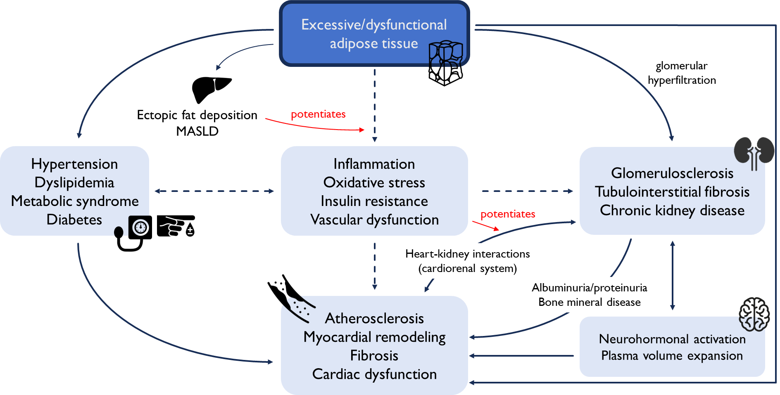
Obesity and CKM health
Source: Manne-Goehler et al, 2025 PLOS Medicine

Slide 8
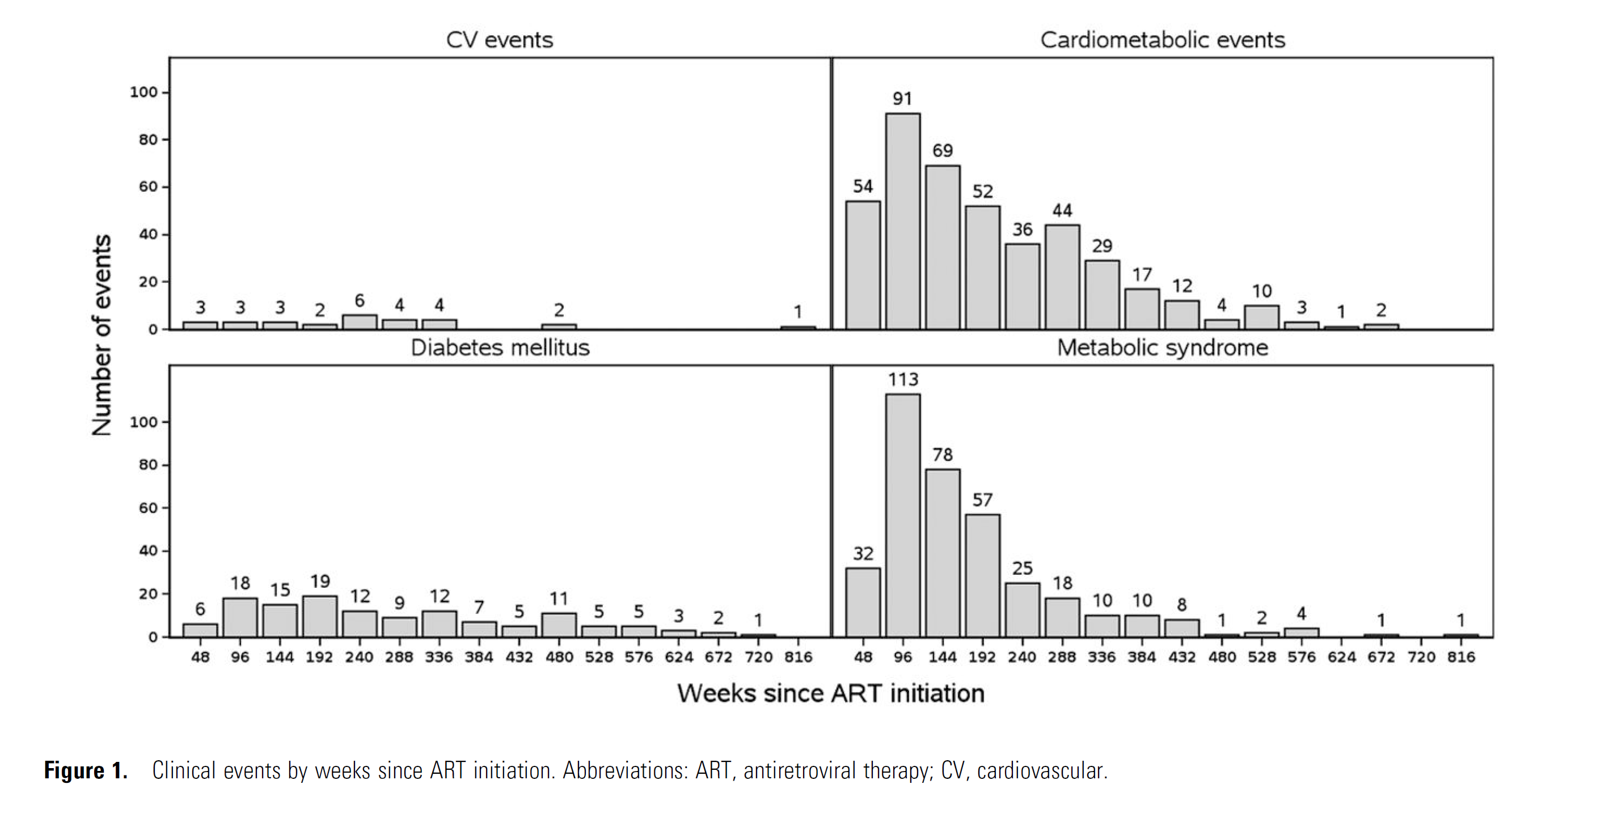
CKM health risks with weight gain on ART
2,624 PLWH in ACTG trials
81% men, 60% non-white
If ≥10% gain over 48 weeks:
2X risk of new diabetes
2.2X risk of new MetS
1.5X risk of CMD events
Over a 10-year horizon…
Source: Bares et al, CID 2024

Slide 9
Liraglutide for Obesity in HIV – a trial in KZN
Notes:
Liraglutide for Obesity in HIV (LIROH) – a trial in KZN

Slide 10
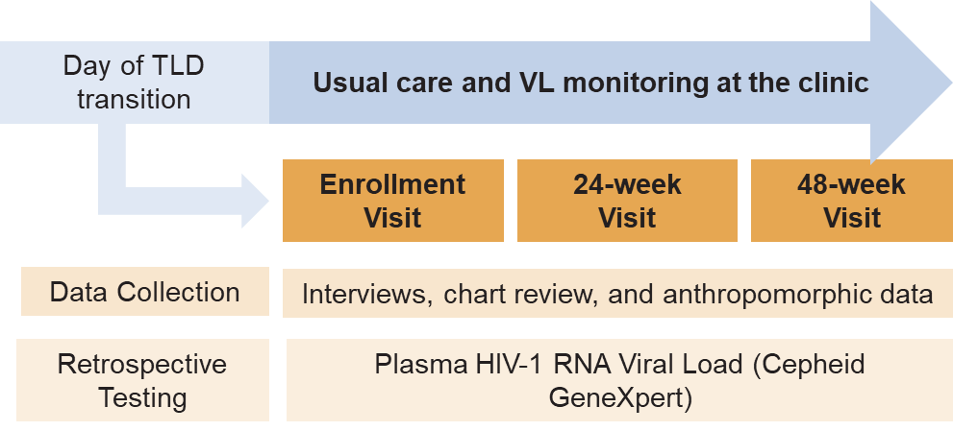
The DISCO Metabolic Study in Uganda and South Africa
Study design
Population Effectiveness of Dolutegravir Implementation in Sub-Saharan Africa
Prospective, observational cohort
1,000 people in rural Uganda + South Africa
Study Aims
To assess implementation of TLD in rural clinics
To quantify viral suppression rates following the transition to TLD
To assess TLD tolerability and discontinuation
Source: The DISCO Study Team

Slide 11
Predicted body weight over 48 weeks in Uganda and South Africa
In South Africa, 18% of participants gained ≥10% of their body weight compared to 9% in Uganda
Source: Migisha et al, AIDS
Notes:
Models adjusted for age, sex, education and prior ART duration

Slide 12
…qualitative interviews with 26 PLWH in KZN…
Theme | Quotation
Above-average body size is viewed as “normal” and preferable to being thin | “A small body size means you are sick. If you are weighing a higher weight scale that means you are healthy.” (Female, 32)
TLD transition believed to contribute to weight gain | “I think I have gained more weight due to the treatment I am using because I never had a heavy body.” (Female 28)
Interest in weight management exercise program but prefer to workout in groups | “I can’t [workout] by myself; it would be better I [exercise] with a group… [exercising alone] I would keep on postponing…and feeling lazy.” (Female, 34)
Interest in pharmacologic option for weight loss | “I am interested in losing weight…I can take it [weight loss pill] if it has fewer side effects.” (Female 28)
Source: Manyaapelo et al, Under Review

Slide 13
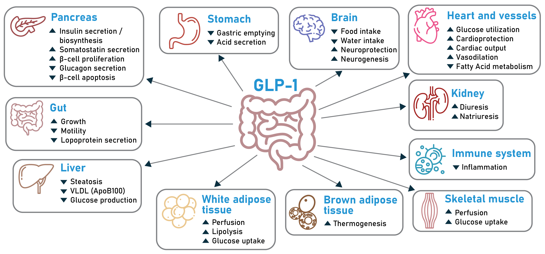
GLP-1 receptor agonist class

Slide 14
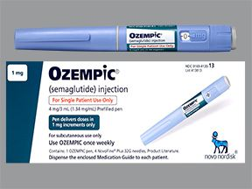

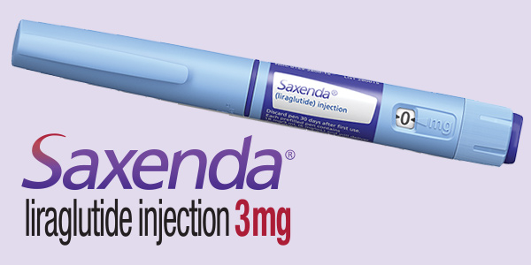
GLP-1 receptor AGONIST CLASS
Liraglutide
(GLP-1 agonist)
Daily SC administration
2. Semaglutide
(GLP-1 agonist)
Weekly SC or daily PO administration
3. Tirzepatide
(GLP-1/GIP dual agonist)
Weekly SC administration

Slide 15
Liraglutide for Obesity in HIV (LIROH), NCT06438146
Obesity and diabetes are important comorbidities for PLWH in Southern Africa
GLP-1 RAs promising for obesity in people without HIV but little data on their use in PLWH in Southern Africa
The purpose of this study was to assess the acceptability & preliminary efficacy of liraglutide for obesity in PLWH stable on ART

Slide 16
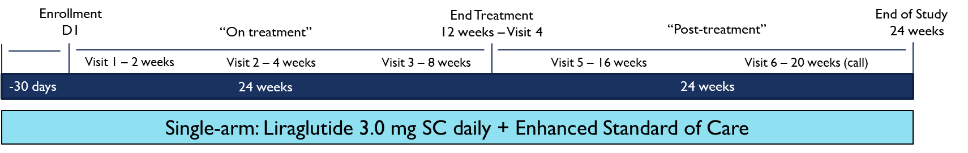
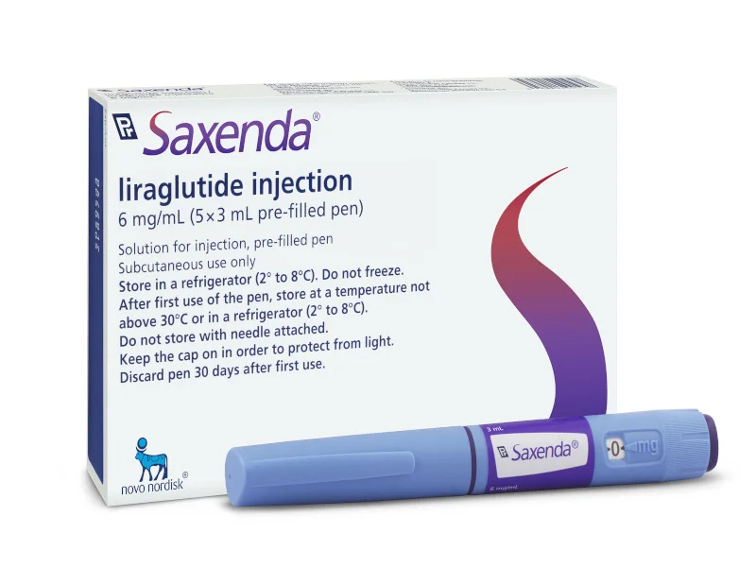




LIROH Study design
12 weeks
12 weeks
PWH on TLD & BMI ≥30 kg/m²
Single-arm, open-label design with approved GLP-1 RA (liraglutide SC daily)

Slide 17

Dose escalation and treatment schedule
Liraglutide Treatment
WEEKS 5-12
WEEK 4
WEEK 3
3,0 mg
WEEK 2
WEEK 1
1,8 mg
2,4 mg
Therapeutic / Maintenance Dose
0,6 mg
1,2 mg

Slide 18
Enrollment

Slide 19
Baseline cohort characteristics
 | Total (n=40)
Age, years | 38 (5)
Female | 39 (98%)
Bodyweight, kg | 103 [89, 109]
BMI, kg/m² | 38 [35, 43]
Systolic blood pressure, mmHg | 123 [114, 135]
Diastolic blood pressure, mmHg | 84 [76, 87]
LDL, mmol/L | 2.7 (0.8)
HDL, mmol/L | 1.2 (0.3)
HbA1c, % | 5.7 (0.5)
Table Legend: Data are mean (standard deviation), median [interquartile range], or n (%) where appropriate. LDL=low-density lipoprotein, HDL= high-density lipoprotein, HbA1c=hemoglobin A1c.

Slide 20
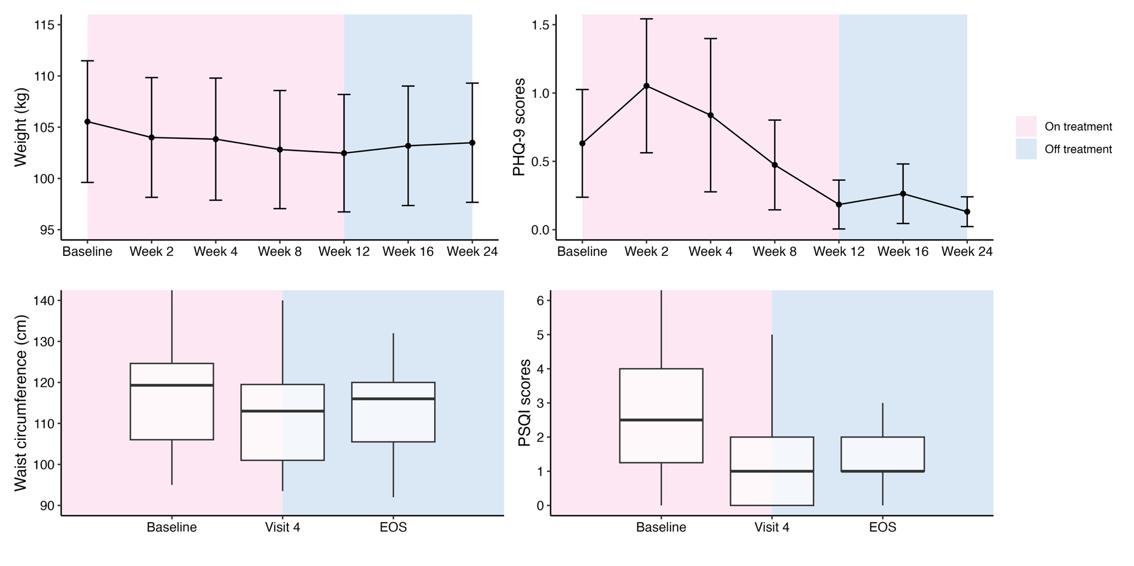
Change in weight and depressive symptoms

Slide 21
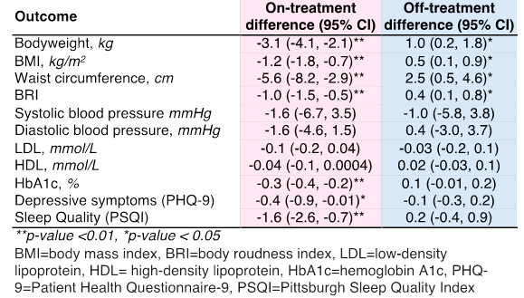
On-treatment and off-treatment changes

Slide 22
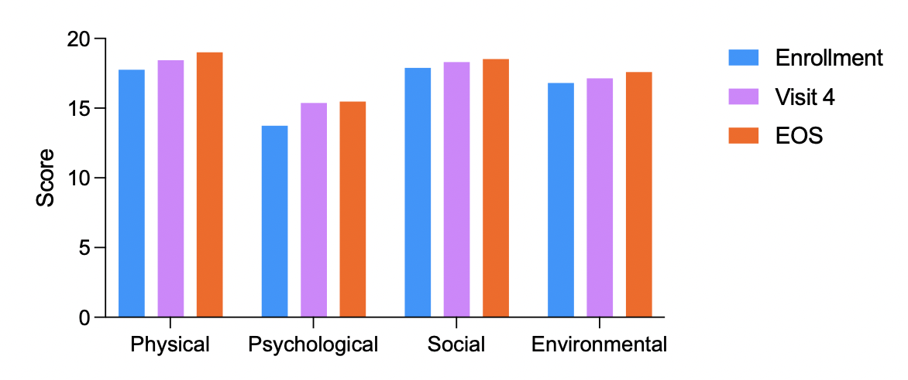
Quality of life per WHOQOL-HIV-BREF

Slide 23
LIROH conclusions
This trial is among the first studies of GLP-1 RAs in Southern Africa and demonstrates that this class for obesity treatment among PWH in this region is highly acceptable
Participants experienced substantial reductions in weight, BMI, waist circumference, and body roundness index with liraglutide.
In addition, mean HbA1c fell while depressive symptoms, sleep quality, and psychological QoL all improved significantly with treatment.

Slide 24
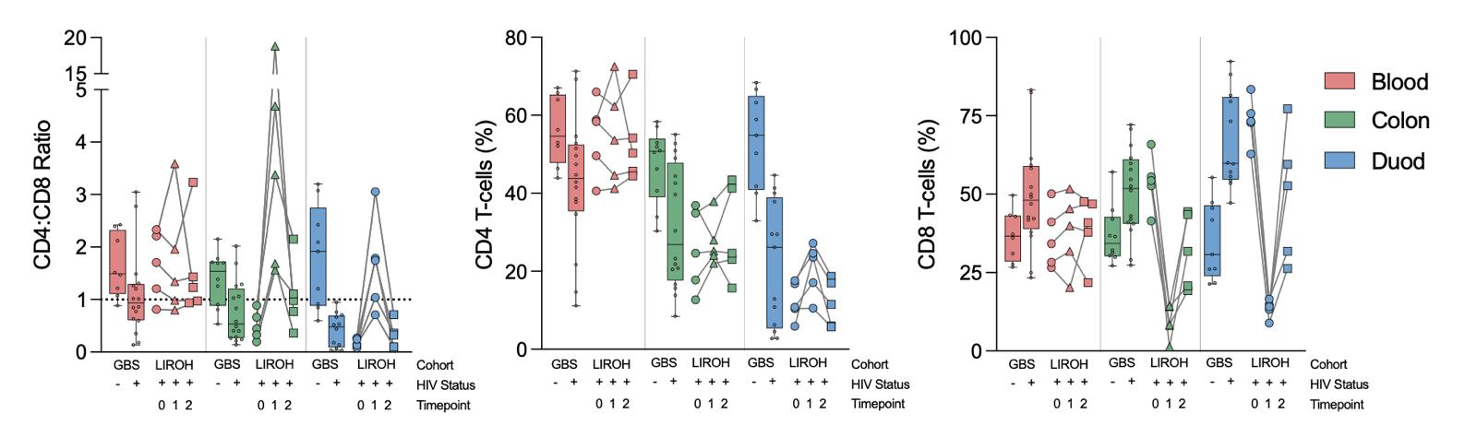
Frontier 1 – biopsies and the “leaky gut hypothesis”

Slide 25
Frontier II – adherence to GLP-1 RAs in HIV
On-treatment changes by Proportion of Days Covered (PDC) >80%
 | Total change | Does not meet PDC | Meets PDC
Bodyweight, kg | -3.1 (-4.02, -2.14)** | -2.5 (-3.80, -1.21)** | -3.7 (-4.92, -2.48)**
BMI, kg/m² | -1.2 (-1.77, -0.69)** | -1.0 (-1.99, -0.10)** | -1.6 (-2.33, -0.92)**
Waist circumference, cm | -5.6 (-8.10, -3.00)** | -5.0 (-9.33, -0.66)** | -5.3 (-7.79, -2.87)**
BRI | -1.0 (-1.49, -0.48)** | -0.9 (-1.78, -0.01)* | -1.0 (-1.43, -0.51)**
Systolic blood pressure, mmHg | -1.6 (-6.50, 3.29) | 2.9 (-3.41, 9.20) | -6.1 (-12.69, 0.43)*
Diastolic blood pressure, mmHg | -1.6 (-4.47, 1.36) | 1.3 (-2.68, 5.31) | -4.6 (-8.29, -0.93)**
LDL, mmol/L | -0.1 (-0.18, 0.04) | -0.1 (-0.28, 0.07) | -0.0 (-0.14, 0.09)
HbA1c, % | -0.3 (-0.44, -0.24)** | -0.3 (-0.44, -0.17)** | -0.4 (-0.54, -0.24)**
Depressive symptoms (PHQ-9) | -0.4 (-0.87, -0.02)** | -0.6 (-1.16, -0.11)** | -0.5 (-1.09, 0.14)
Sleep quality (PSQI) | -1.6 (-2.55, -0.69)** | -1.4 (-2.75, -0.09)* | -1.9 (-3.02, -0.71)**
Sitting duration (mins) | 10.8 (-40.54, 62.06) | 61.0 (-27.36, 149.36) | -23.8 (-73.72, 26.10)
SSB intake | -315.0 (-495.59, -134.41)** | -214.2 (-425.04, -3.38)* | -355.2 (-606.01, -104.42)**
Physical QOL | 0.7 (-0.17, 1.52) | 0.9 (-0.24, 1.99) | 0.5 (-0.61, 1.55)
Psychological QOL | 1.6 (0.81, 2.45)** | 1.4 (0.24, 2.64)** | 1.8 (0.82, 2.72)**
Social QOL | 0.4 (-0.83, 1.68) | 1.0 (-1.12, 3.09) | -0.1 (-1.36, 1.12)
Environmental QOL | 0.3 (-0.96, 1.62) | 0.5 (-1.34, 2.30) | 0.2 (-1.43, 1.93)

Slide 26
Implications for public health & clinical practice in HIV

Slide 27





Study #1. ACTG 5371 “SLIM Liver”
Study of Semaglutide for Non-Alcoholic Fatty Liver Disease, a Metabolic Syndrome with Insulin Resistance, Increased Hepatic Lipids, and Increased Cardiovascular Disease Risk
The SLIM LIVER Study
Phase IIb, open-label, single-arm pilot (n=49)
Semaglutide 1.0 mg weekly X 24 weeks
Primary outcome: intrahepatic triglyceride (IHTG) by MRI-proton density fat fraction (PDFF)
Inclusion Criteria:
PWH
≥18 years
On ART
Central adiposity + insulin resistance,
SLD
IHTG ≥5%
Source: Lake et al, 2024

Slide 28
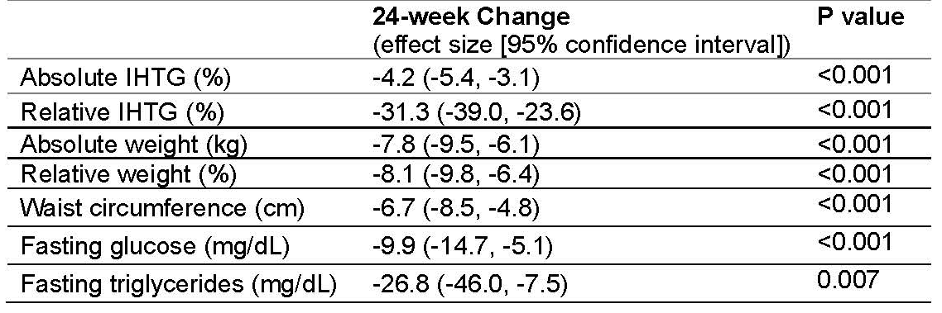
ACTG 5371 SLIM LIVER STUDY
Improvements in IHTG correlated with weight loss on semaglutide (p<0.0001)
Baseline IHTG: 12.7%
29% with complete resolution of MASLD (IHTG <5%)
58% with ≥30% relative reduction of MASLD
Greater improvements in women, non-white and older age people
28
Source: Lake et al, 2024

Slide 29
Study #2. Semaglutide in HIV-associated lipohypertrophy
Inclusion Criteria
Randomised, double-blind, placebo-controlled phase 2b clinical trial
Single-site, n=108 people
Semaglutide 1.0 mg weekly X 32 weeks
PWH
≥18 years old
On ART
BMI 25+ &
high waist circumference
People with known diabetes excluded
Source: Eckard et al, 2024

Slide 30
Semaglutide effects in hiv-associated lipohypertrophy
Weight decreased 8.3% [v. 0.2%]
65% on semaglutide lost ≥5% [v. 4%]
Visceral Adipose Tissue decreased 8.3% [v. increasing 0.2%]
30
Source: Eckard et al 2024

Slide 31
Semaglutide effects in hiv-associated lipohypertrophy
Lean muscle mass decreased 5.4% [v. 0.6%]
Subcutaneous adipose tissue decreased 13% [v. increasing 1.5%]
31
Source: Eckard et al 2024

Slide 32
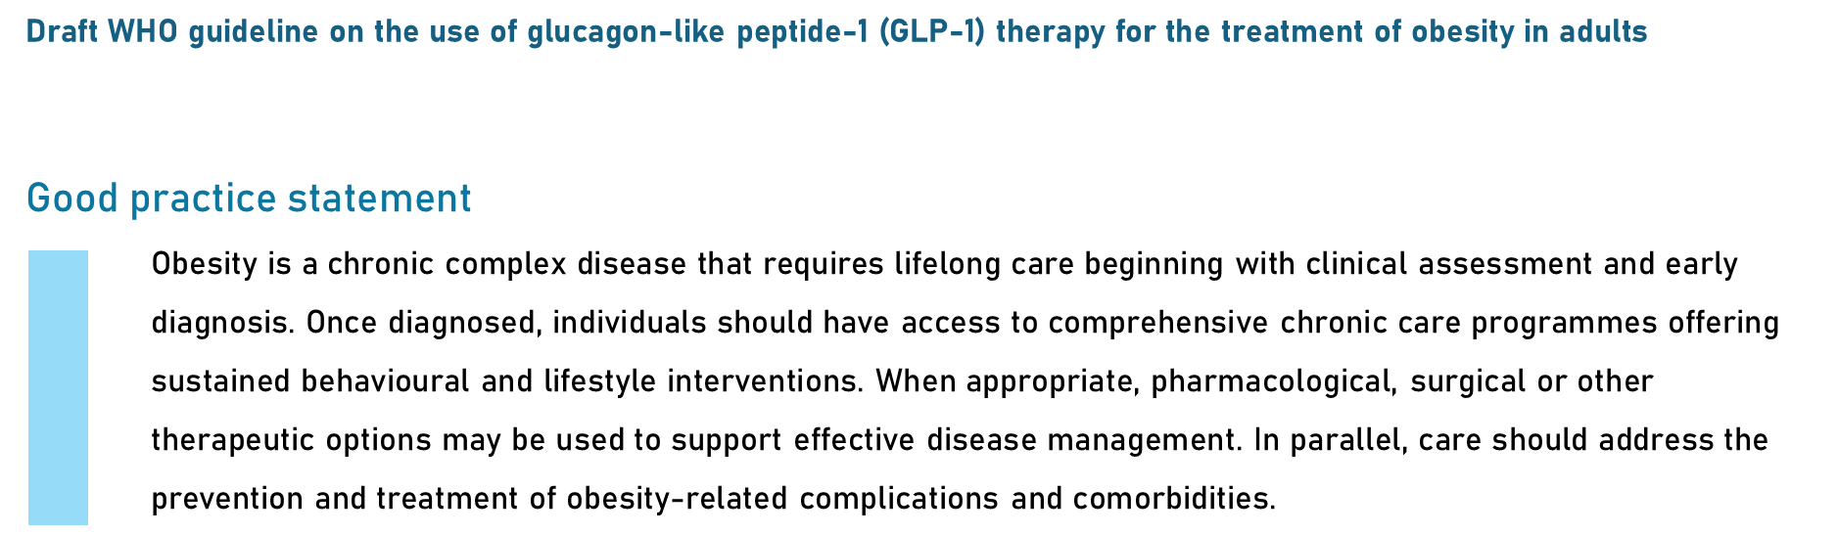

WHO recommendations released for public comment

Slide 33
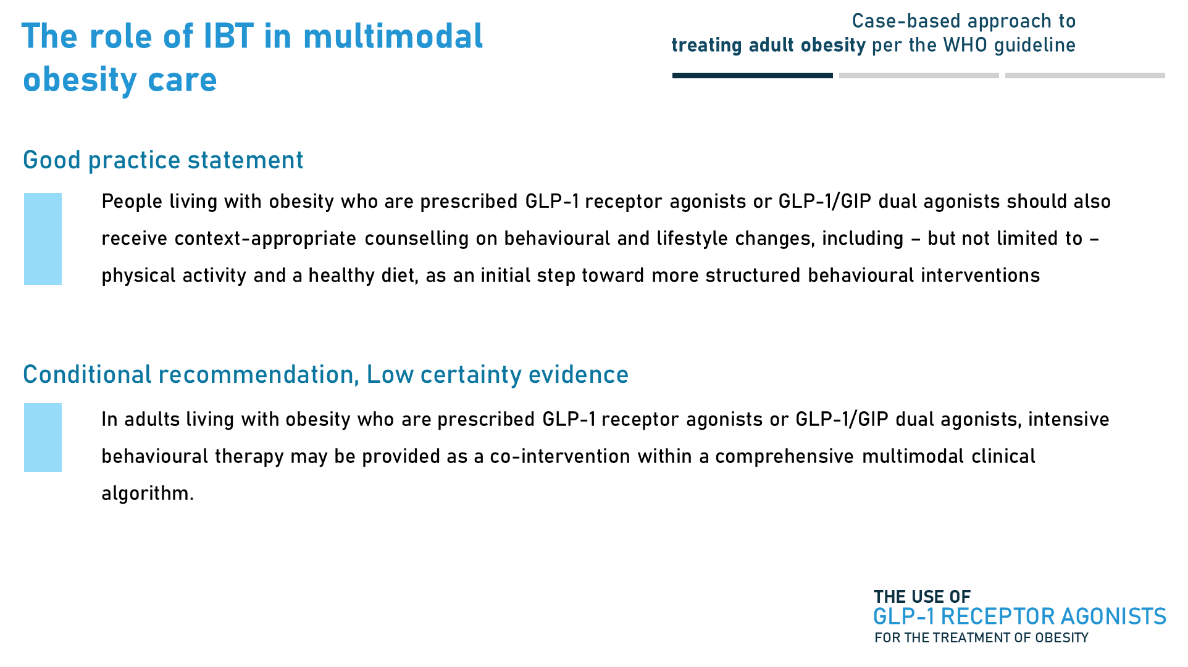
WHO recommendations released for public comment

Slide 34

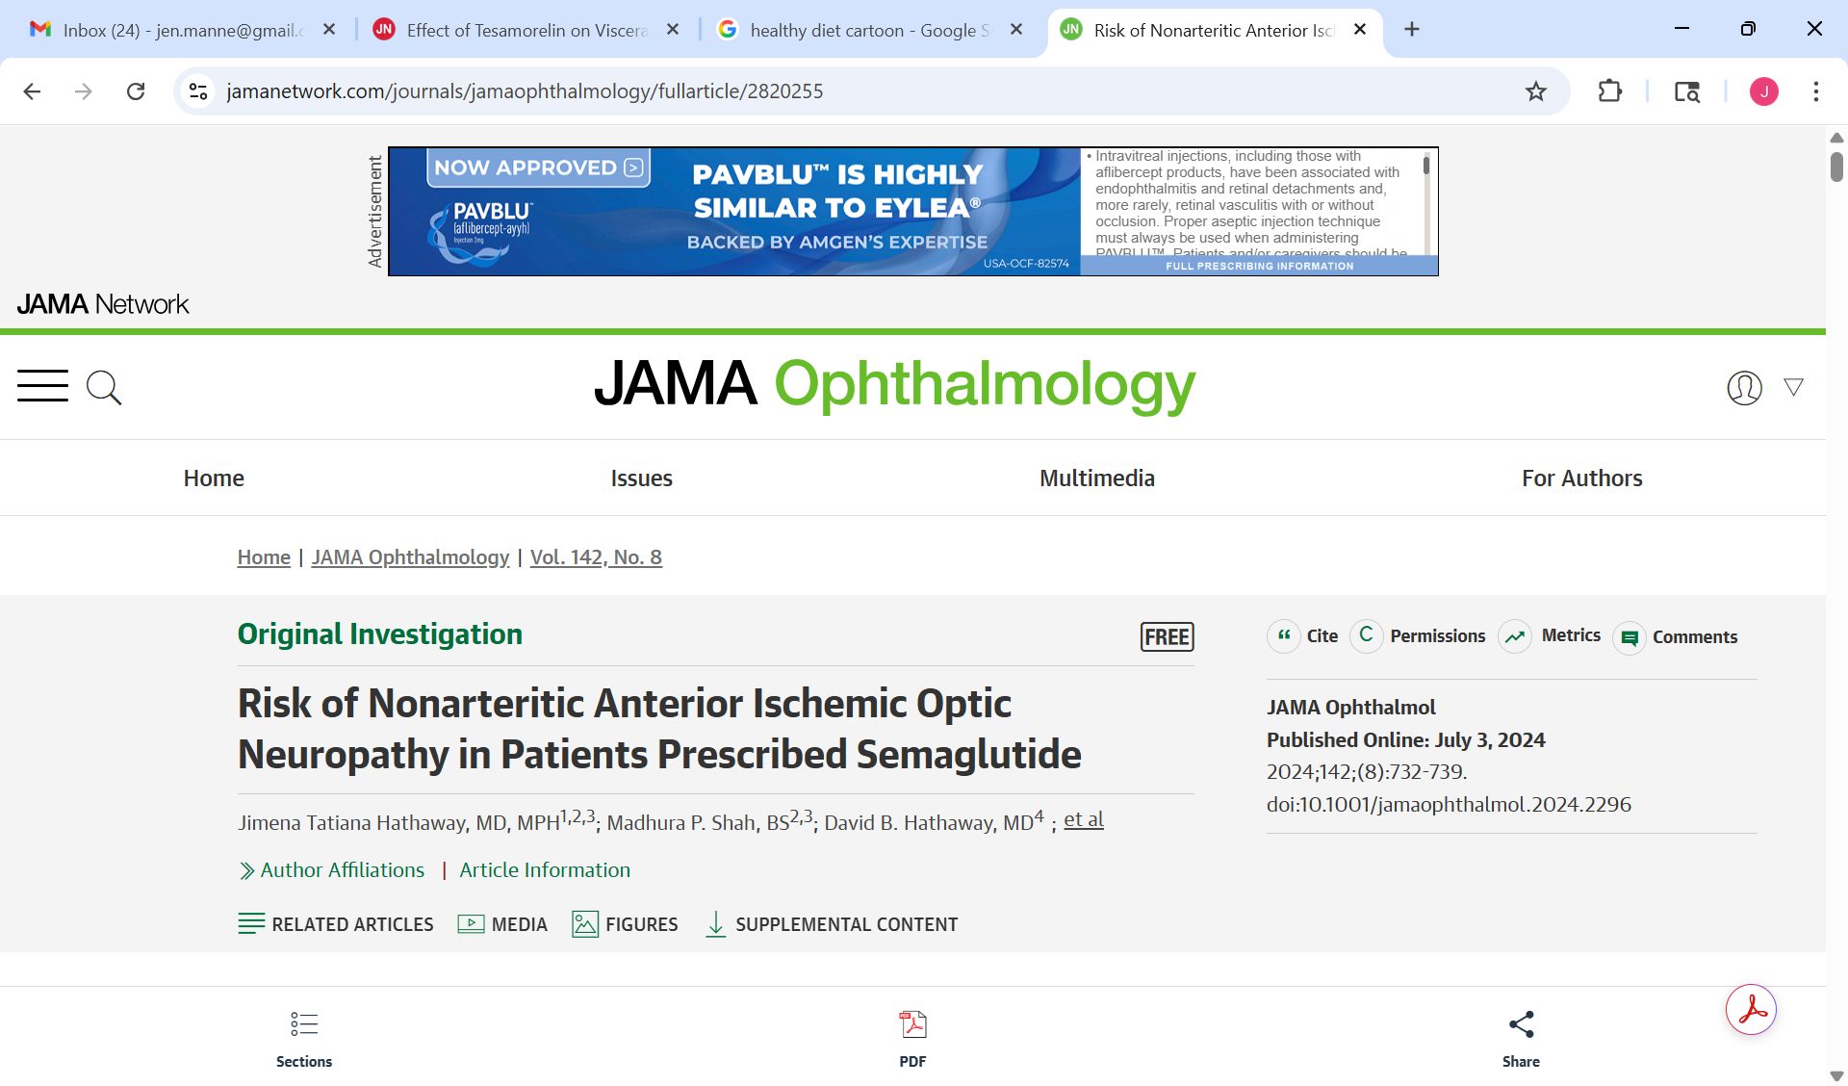
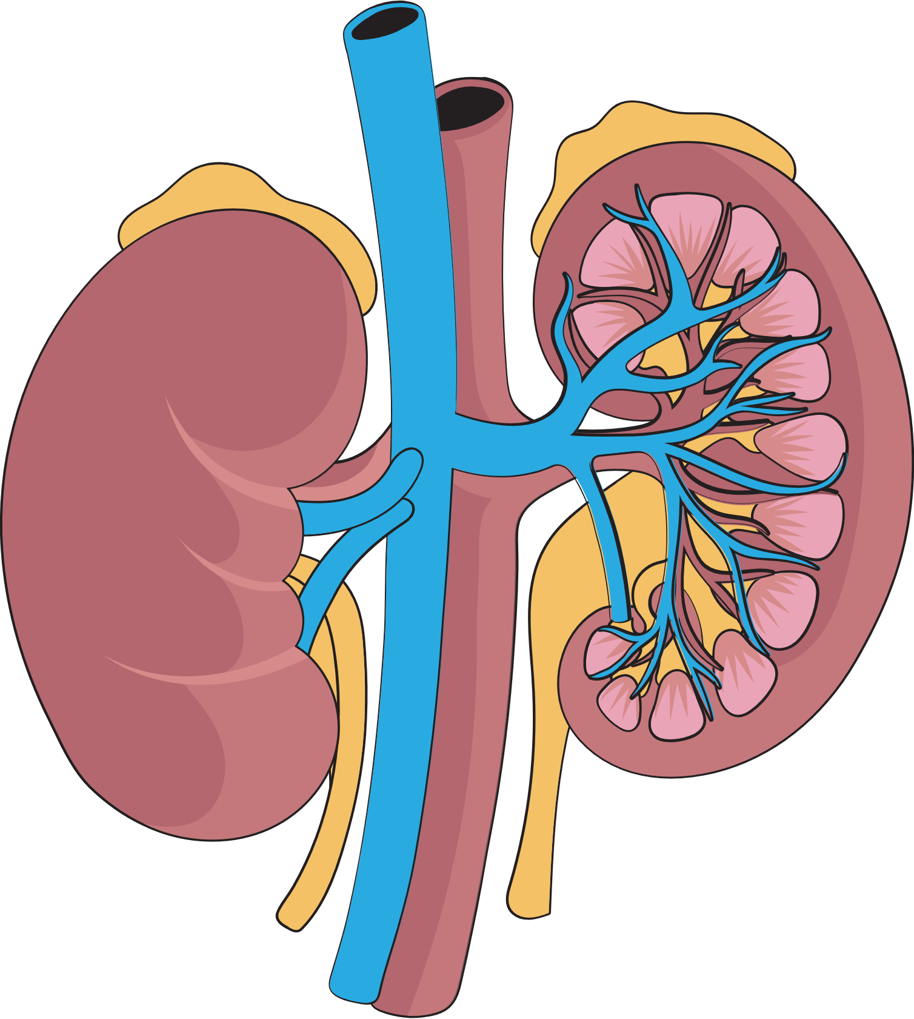
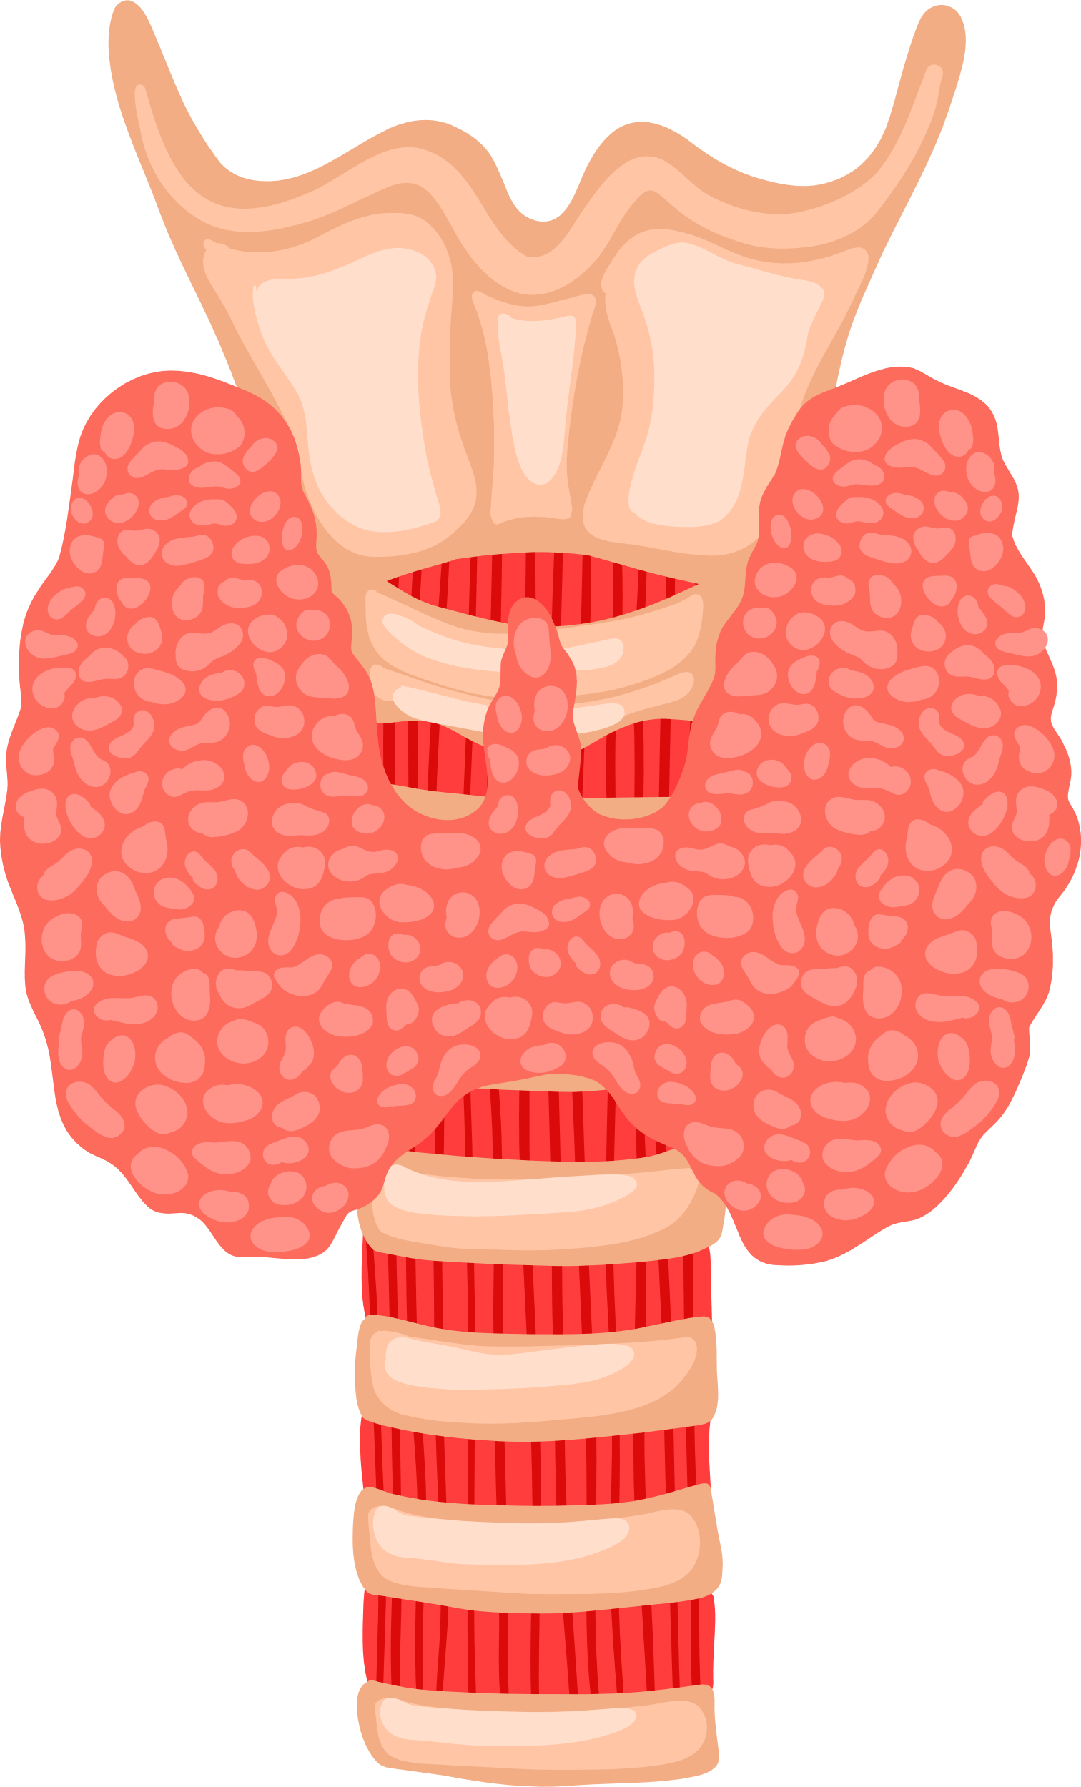

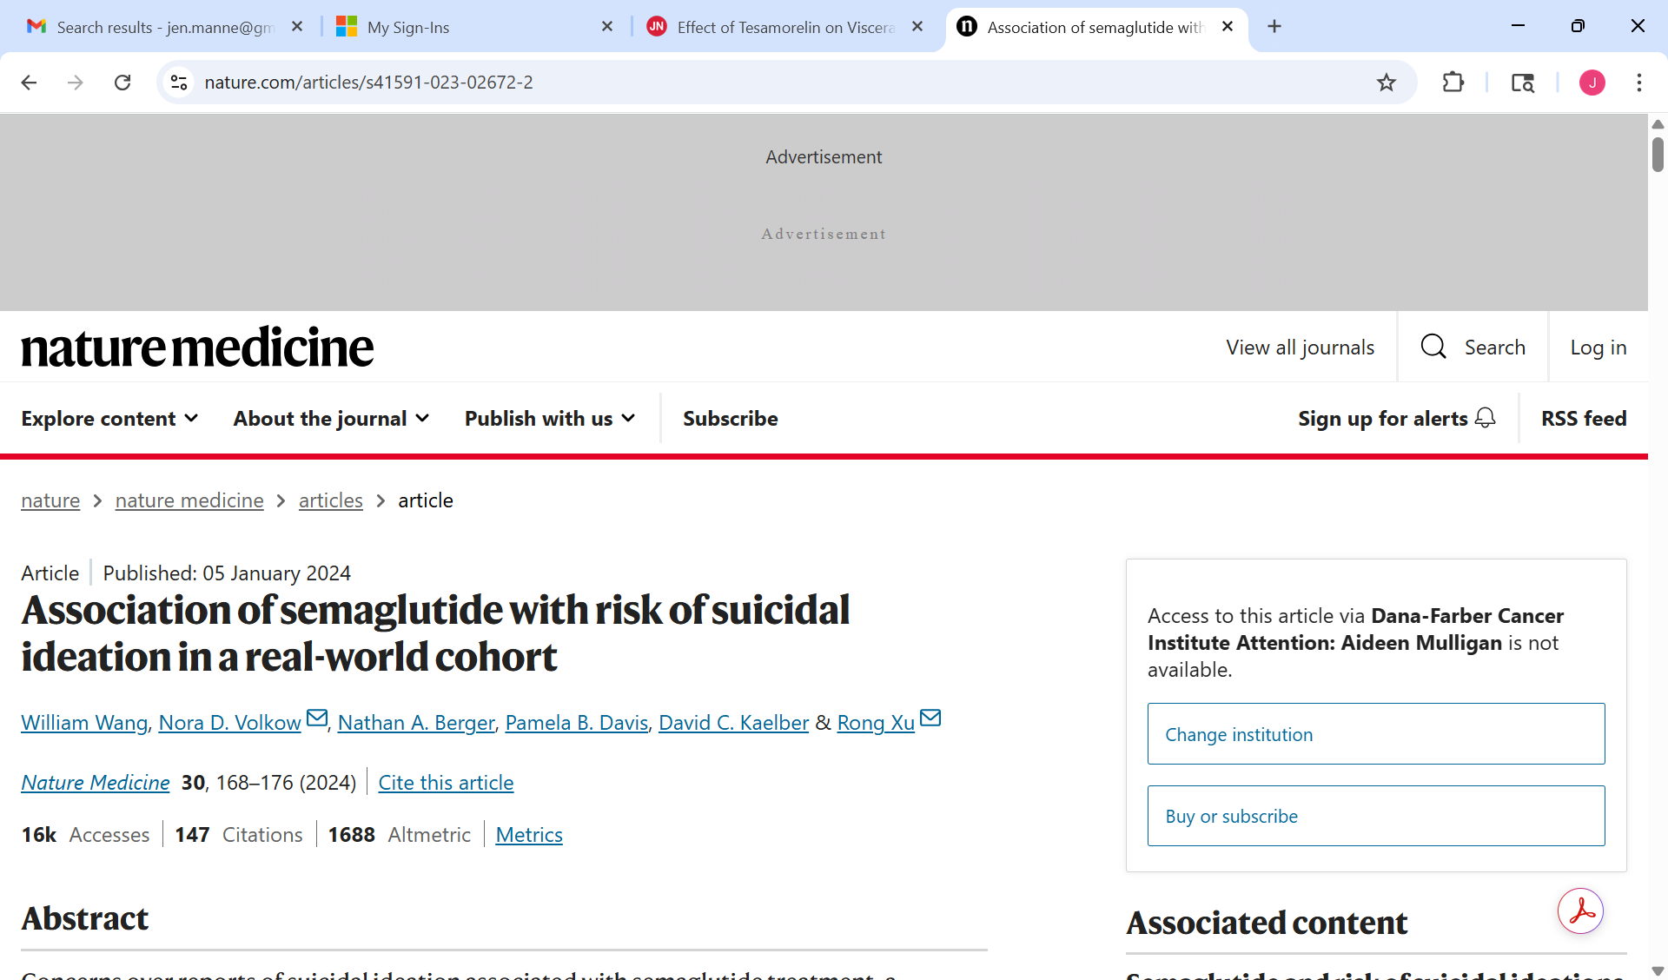
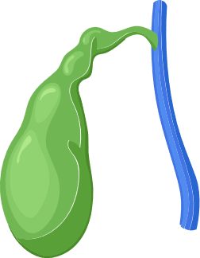

Side effects of GLP-1 RAs
Acute Kidney Injury
Thyroid Cancer
Pancreatitis
Gallbladder Disease
Allergic Reactions
Source: Manne-Goehler
and Franco, BMJ 2025

Slide 35
Conclusions
PWH have a high risk of weight gain and clinical obesity with the transition to TLD, these may further increase risk of CKM complications
Emerging evidence is demonstrating the possible value of novel obesity management medications such as GLP-1 RAs in PWH but global access remains a challenge
Early evidence in KZN suggests that patients are accepting of GLP-1 RAs and they have preliminary efficacy for metabolic endpoints but much more to learn.

Slide 36
Thank you to my [awesome] collaborators/mentors:
AHRI CTU – Limakatso Lebina, Osee Behuhuma, Gugu Gasa, Anne Derache, Sfundo Khumalo, Bhule Nhlapo, Kristien Bird
Paul Sax
Mark Siedner
Mohammed Ali
Nomathemba Chandiwana
Janet Lo
Francois Venter

Slide 37
Selected references
Lake JE, Kitch DW, Kantor A, Muthupillai R, Klingman KL, Vernon C, Belaunzaran-Zamudio PF, Fichtenbaum CJ, Heath S, Perazzo H, Corey K, Brown TT, Landay A, Sattler F, Erlandson KM. The Effect of Open-Label Semaglutide on Metabolic Dysfunction-Associated Steatotic Liver Disease in People With HIV. Ann Intern Med. 2024 Jun;177(6):835-838. doi: 10.7326/M23-3354. Epub 2024 Apr 30. PMID: 38684100; PMCID: PMC11210743.
Venter WDF, Moorhouse M, Sokhela S, Fairlie L, Mashabane N, Masenya M, Serenata C, Akpomiemie G, Qavi A, Chandiwana N, Norris S, Chersich M, Clayden P, Abrams E, Arulappan N, Vos A, McCann K, Simmons B, Hill A. Dolutegravir plus Two Different Prodrugs of Tenofovir to Treat HIV. N Engl J Med. 2019 Aug 29;381(9):803-815. doi: 10.1056/NEJMoa1902824. Epub 2019 Jul 24. PMID: 31339677.
Manne-Goehler J, Franco J. Side effects of GLP-1 receptor agonists. BMJ. 2025 Aug 4;390:r1606. doi: 10.1136/bmj.r1606. PMID: 40759433.
Sax PE, Erlandson KM, Lake JE, Mccomsey GA, Orkin C, Esser S, Brown TT, Rockstroh JK, Wei X, Carter CC, Zhong L, Brainard DM, Melbourne K, Das M, Stellbrink HJ, Post FA, Waters L, Koethe JR. Weight Gain Following Initiation of Antiretroviral Therapy: Risk Factors in Randomized Comparative Clinical Trials. Clin Infect Dis. 2020 Sep 12;71(6):1379-1389. doi: 10.1093/cid/ciz999. PMID: 31606734; PMCID: PMC7486849.
Eckard AR, Wu Q, Sattar A, Ansari-Gilani K, Labbato D, Foster T, Fletcher AA, Adekunle RO, McComsey GA. Once-weekly semaglutide in people with HIV-associated lipohypertrophy: a randomised, double-blind, placebo-controlled phase 2b single-centre clinical trial. Lancet Diabetes Endocrinol. 2024 Aug;12(8):523-534. doi: 10.1016/S2213-8587(24)00150-5. Epub 2024 Jul 1. Erratum in: Lancet Diabetes Endocrinol. 2025 Apr;13(4):e7. doi: 10.1016/S2213-8587(25)00051-8. PMID: 38964353; PMCID: PMC11417641.
Migisha R, Chen G, Muyindike WR, Aung TN, Nanfuka V, Komukama N, Chandiwana N, Shazi G, Tien D, Moosa MS, Gupta RK, Pillay D, Marconi VC, Hedt-Gauthier B, Venter WDF, Siedner MJ, McCluskey SM, Manne-Goehler J. Regional variation in weight change after the transition to dolutegravir in Uganda and South Africa. AIDS. 2024 Jul 15;38(9):1314-1322. doi: 10.1097/QAD.0000000000003888. Epub 2024 Mar 19. PMID: 38507584; PMCID: PMC11211050.

Slide 38
Appendix

Slide 39
Clinical pearl regarding the diagnosis of diabetes in PWH…
HbA1c may underestimate glucose intolerance in PWH
Plasma fasting blood glucose is
the preferred test for diabetes in people with HIV
Harder to obtain in clinical practice
Source: Bailin and Koethe, Current HIV/AIDS Reports 2022 and Manne-Goehler et al, The Lancet Diabetes & Endocrinology 2016

Slide 40
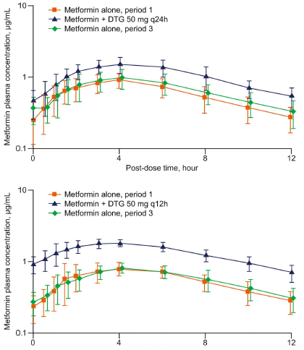
Metformin use in PWH on DTG
DTG
Study Design | Open-label, parallel-group, multi-dose, 3-period crossover study in healthy adults
Mechanism | Partly explained by OCT2 inhibition
Pharmacokinetics (metformin) | DTG 50 mg Q12H ↑ AUC 145% & Cmax 111%
Management | Consider metformin dose adjustment if starting/stopping DTG Avoid metformin >1000mg per day
Source: Song et al, JAIDS 2016

Slide 41


Strategy #1: lifestyle change…is complicated
DIET and EXERCISE important for health but do not often lead to sustained weight loss!
Obesity driven by modern food environment, social determinants of health, genetics, etc.
Obesity is a highly stigmatized condition by both public and health workers…
Source: The Guardian

Slide 42
Strategy #1: lifestyle change…is complicated
10 years after the Diabetes Prevention Program (DPP):
#1 – Participants in lifestyle change program had an average delay in diabetes onset of 4 years
#2 – People who took metformin had a delay of about 2 years
DPP objective: to prevent or delay the onset of T2DM with proven, achievable interventions including lifestyle change – especially in people at greatest risk
Source: NIDDK, DPP Research Group 2009

